Slide 1
Supervised and Unsupervised Learning

Slide 2
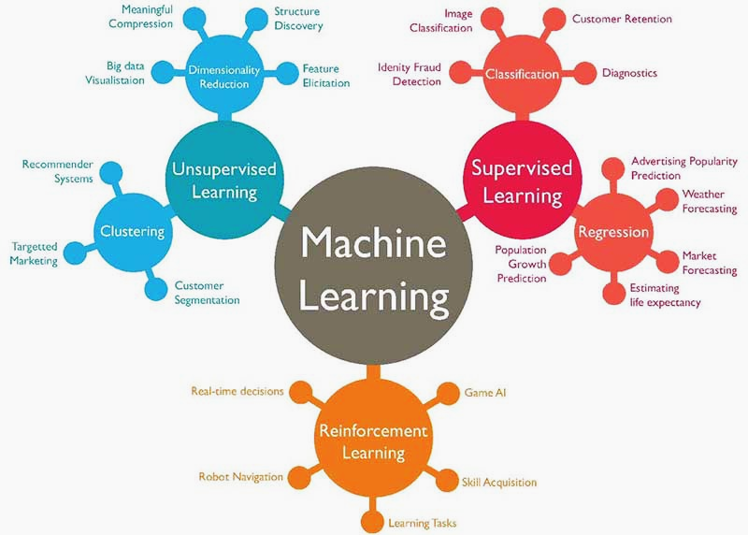
Different Machine Learning Paradigms

Slide 3
Supervised Learning
To learn an unknown target function f
Input: a training set of labeled examples (x_{j},y_{j}) where y_{j} = f(x_{j})
E.g., x_{j} is an image, f(x_{j}) is the label “giraffe”
Output: hypothesis h that is “close” to f, i.e., predicts well on unseen examples (“test set”)
Many possible hypothesis families for h
Linear models, logistic regression, neural networks, decision trees, examples (nearest-neighbor) etc.

Slide 4
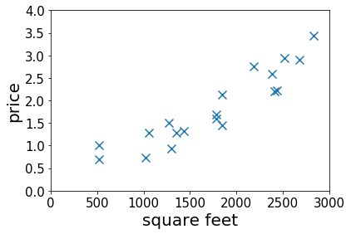
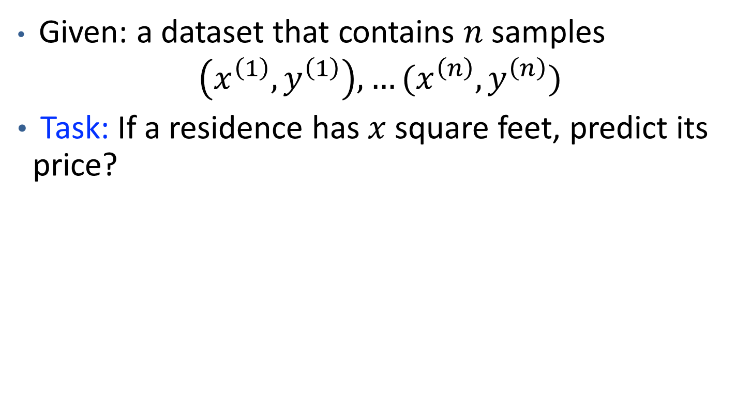
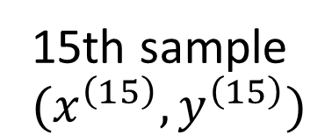
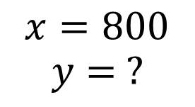
Housing Price Prediction
Given: a dataset that contains $n$ samples
$\left(x^{\left(1\right)},y^{\left(1\right)}\right), …(x^{\left(n\right)},y^{\left(n\right)})$
Task: If a residence has $x$ square feet, predict its price?
15th sample $(x^{\left(15\right)},y^{\left(15\right)})$
$$x=800$$
$$y= ?$$
Notes:
Mention the dataset is the experience

Slide 5
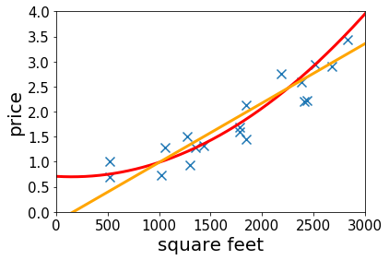
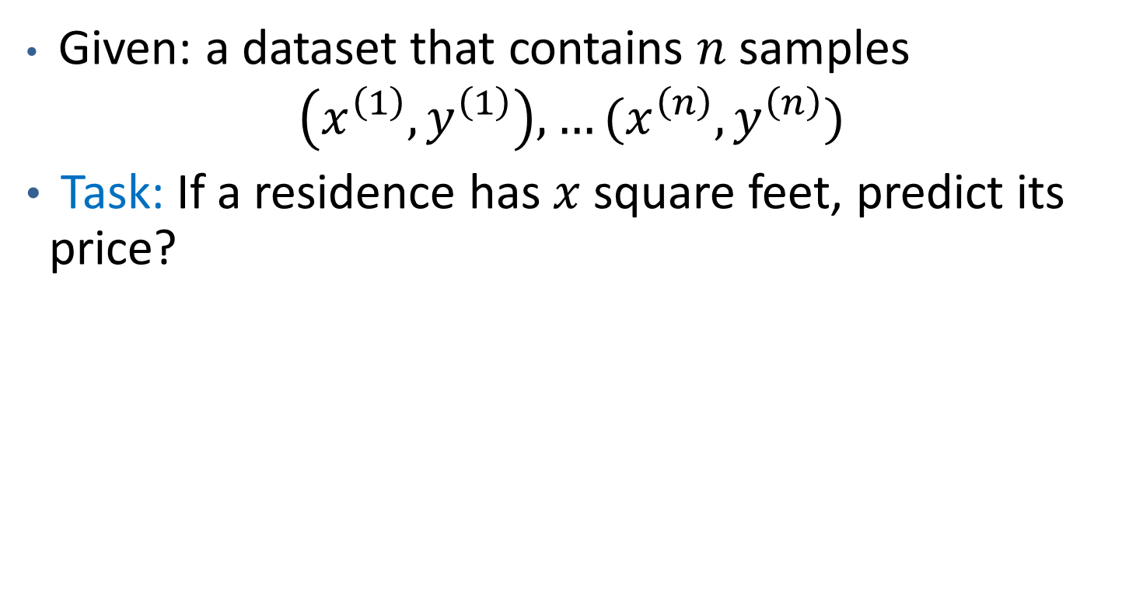
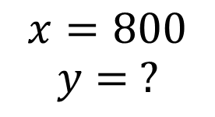
Housing Price Prediction
Given: a dataset that contains $n$ samples
$\left(x^{\left(1\right)},y^{\left(1\right)}\right), …(x^{\left(n\right)},y^{\left(n\right)})$
Task: If a residence has $x$ square feet, predict its price?
15th sample $(x^{\left(15\right)},y^{\left(15\right)})$
$$x=800$$
$$y= ?$$
Solution: fitting linear/quadratic functions to the dataset.
Notes:
Mention the dataset is the experience

Slide 6
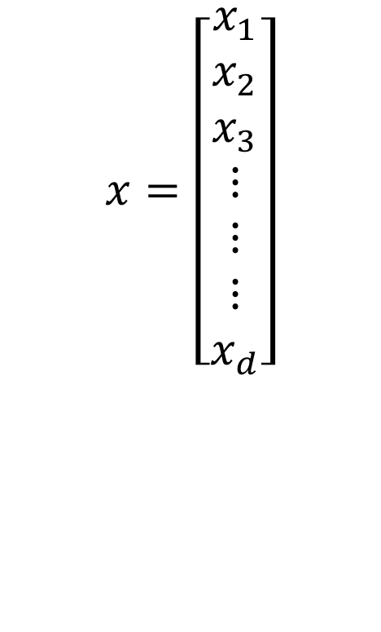

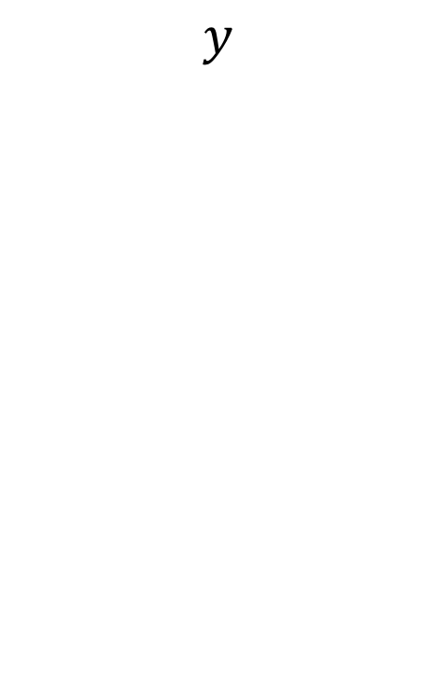
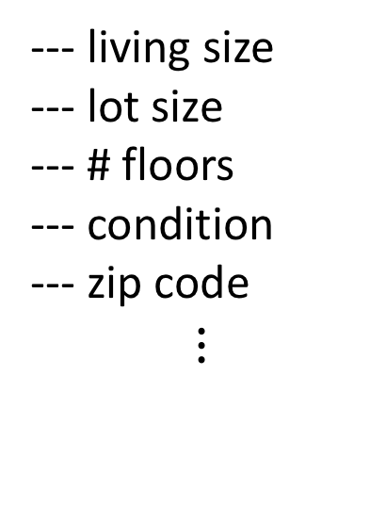
High-dimensional Features
$x∈ℝ^{d}$ for large $d$
E.g.,
--- living size
--- lot size
--- # floors
--- condition
--- zip code
$$⋮$$
$$x=\left[\begin{aligned}x_{1} \\ x_{2} \\ x_{3} \\ ⋮ \\ ⋮ \\ ⋮ \\ x_{d}\end{aligned}\right]$$
--- price
$$y$$

Slide 7
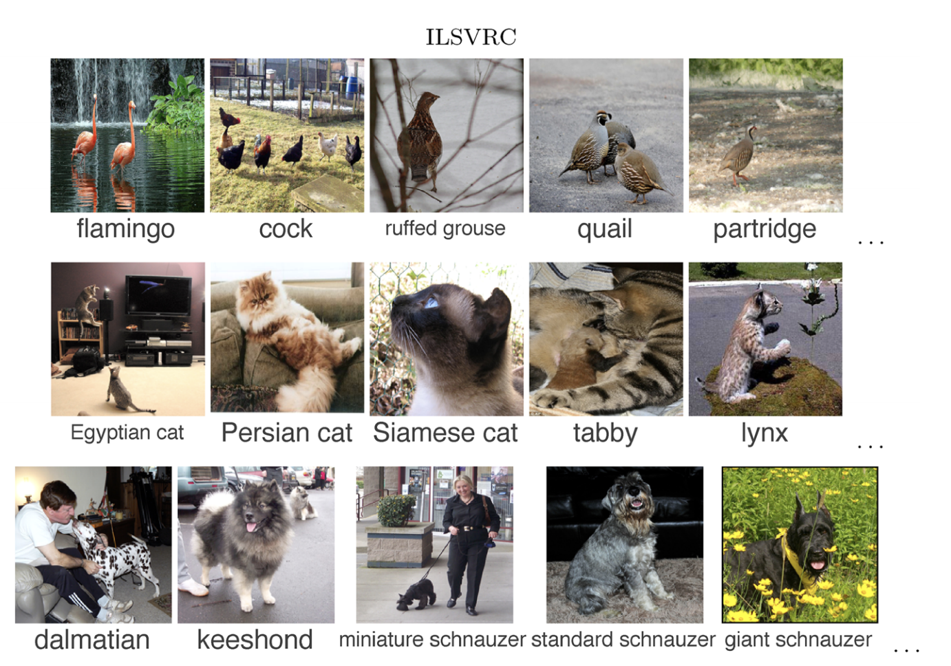
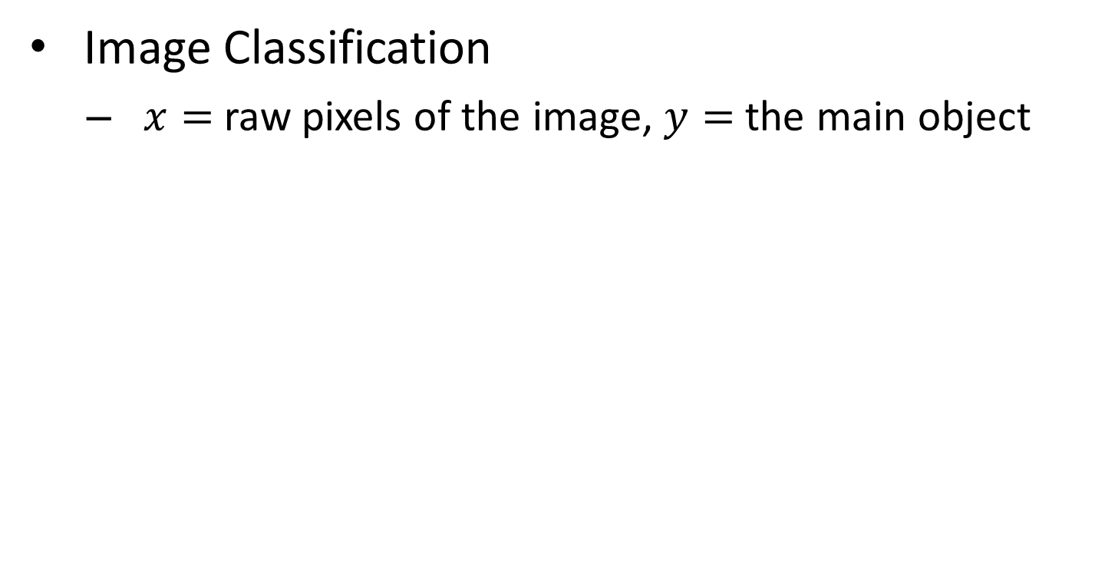
Supervised Learning in CV
Image Classification
$x=$ raw pixels of the image, $y=$ the main object
ImageNet Large Scale Visual Recognition Challenge. Russakovsky et al.’2015

Slide 8
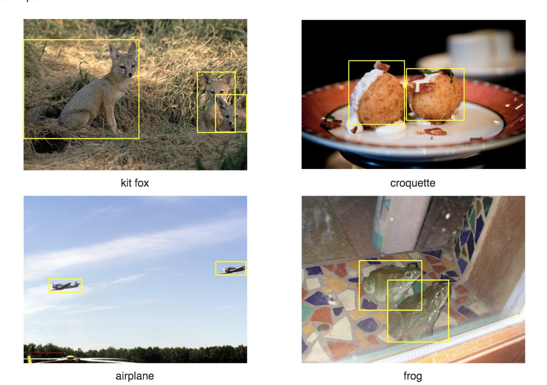
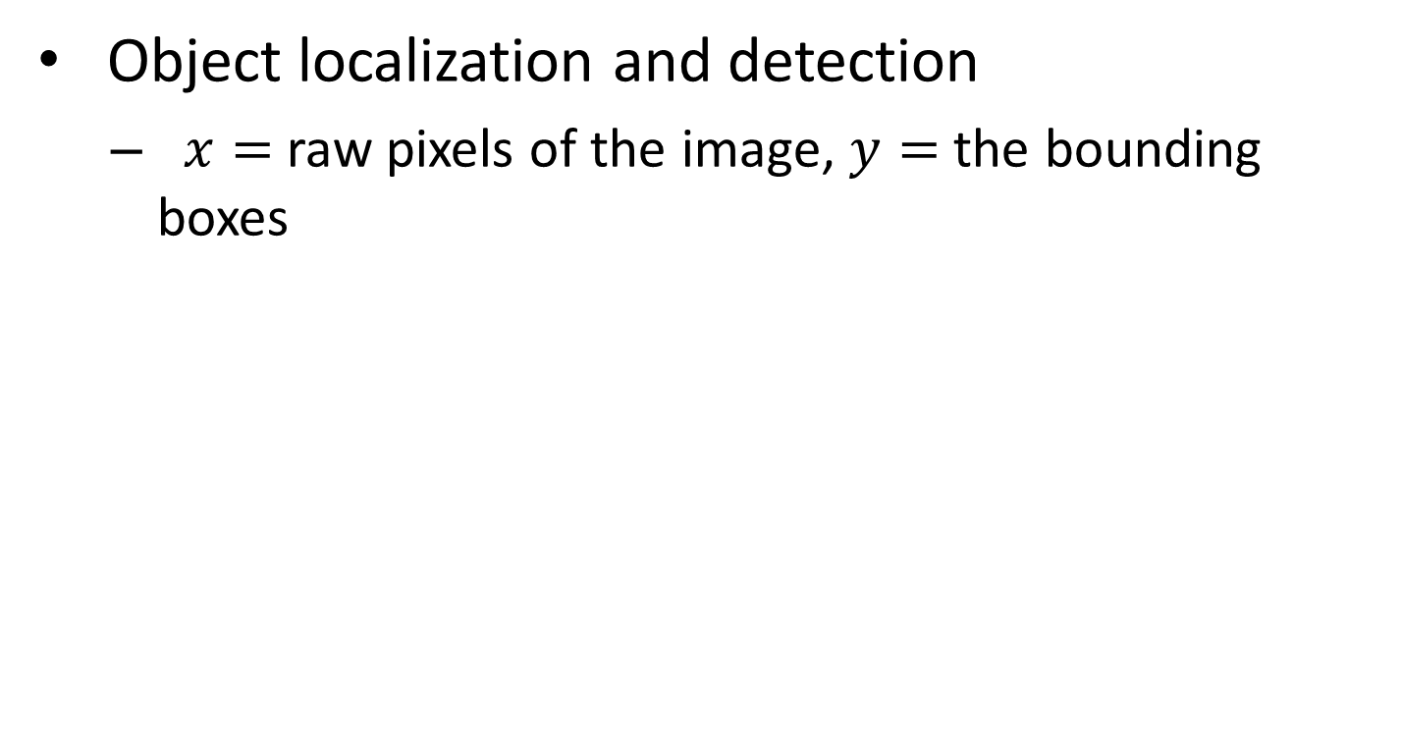
Supervised Learning in CV
Object localization and detection
$x=$ raw pixels of the image, $y=$ the bounding boxes
ImageNet Large Scale Visual Recognition Challenge. Russakovsky et al.’2015

Slide 9
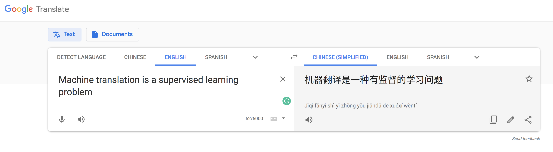
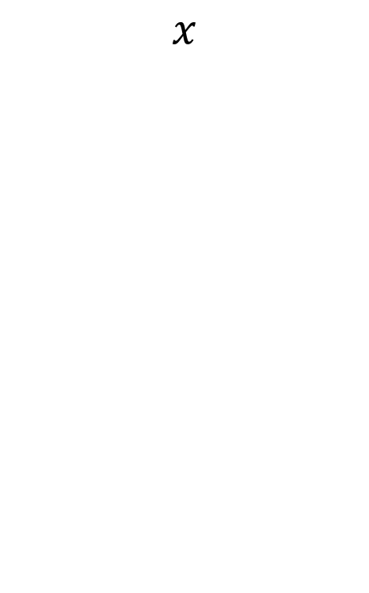
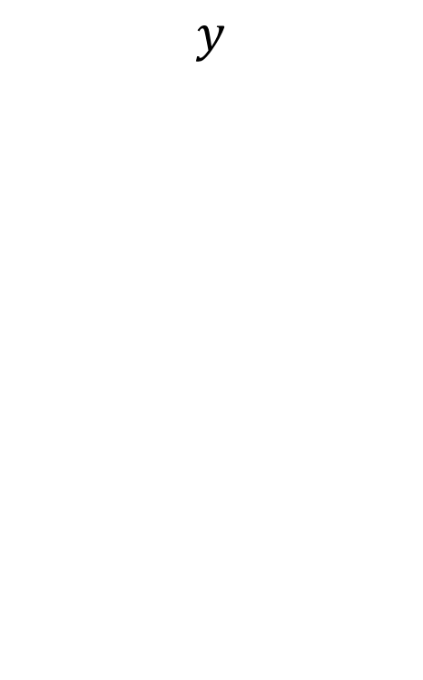
Supervised Learning in Natural Language Processing
Machine translation
$$x$$
$$y$$
Note: This course only covers the basic and fundamental techniques of supervised learning (which are not enough for solving hard vision or NLP problems.)

Slide 10
Supervised Learning
Advantage
You have full control over what the machine is learning.
You can easily test and debug your learning machine.
Since the labelled data is available you can easily inspect its output and find out what errors it’s making on what type of input data.

Slide 11
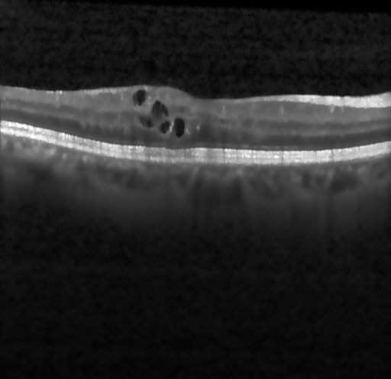
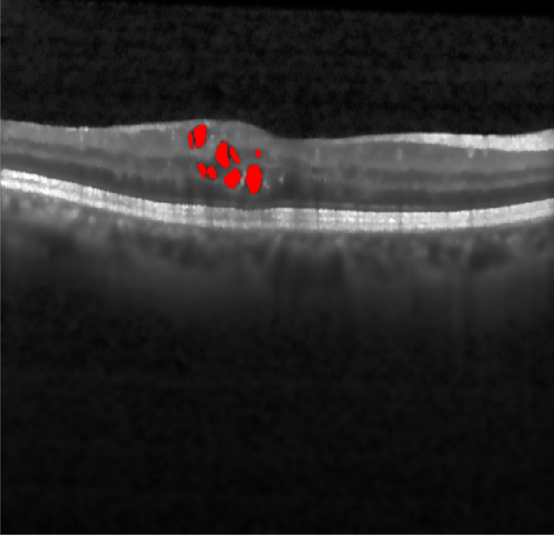
Supervised Learning
Disadvantage
Collecting and labelling data is expensive and time-consuming.
Example: Speech Recognition, Medical Image Analysis, etc.
Errors in your training data might confuse your algorithm and lower its accuracy. Garbage-in -> Garbage-out
Original Retinal Scan
Intra-retinal cysts annotated scan

Slide 12
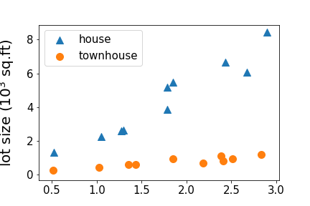
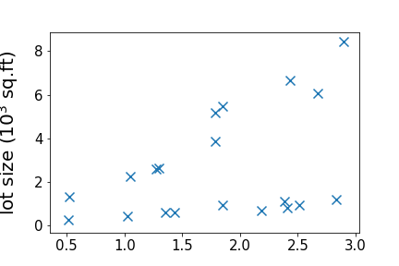
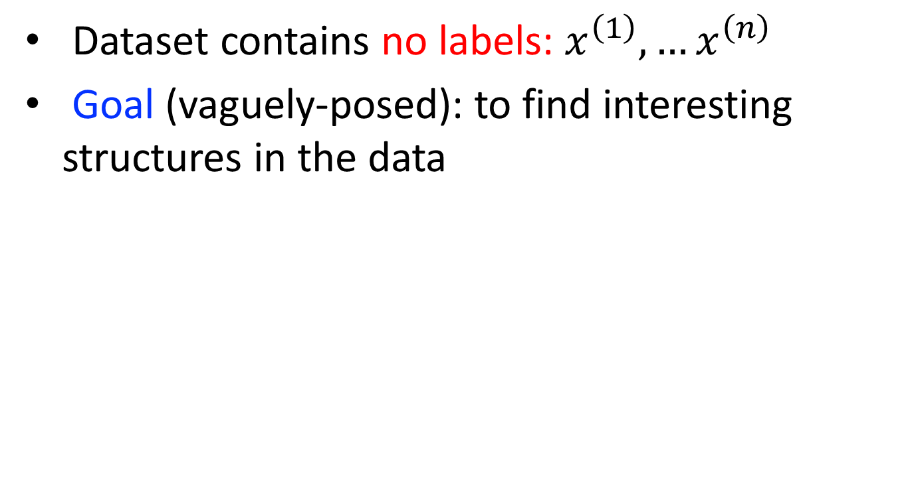
Unsupervised Learning
Dataset contains no labels: $x^{\left(1\right)}, …x^{\left(n\right)}$
Goal (vaguely-posed): to find interesting structures in the data
supervised
unsupervised

Slide 13
Clustering

Slide 14
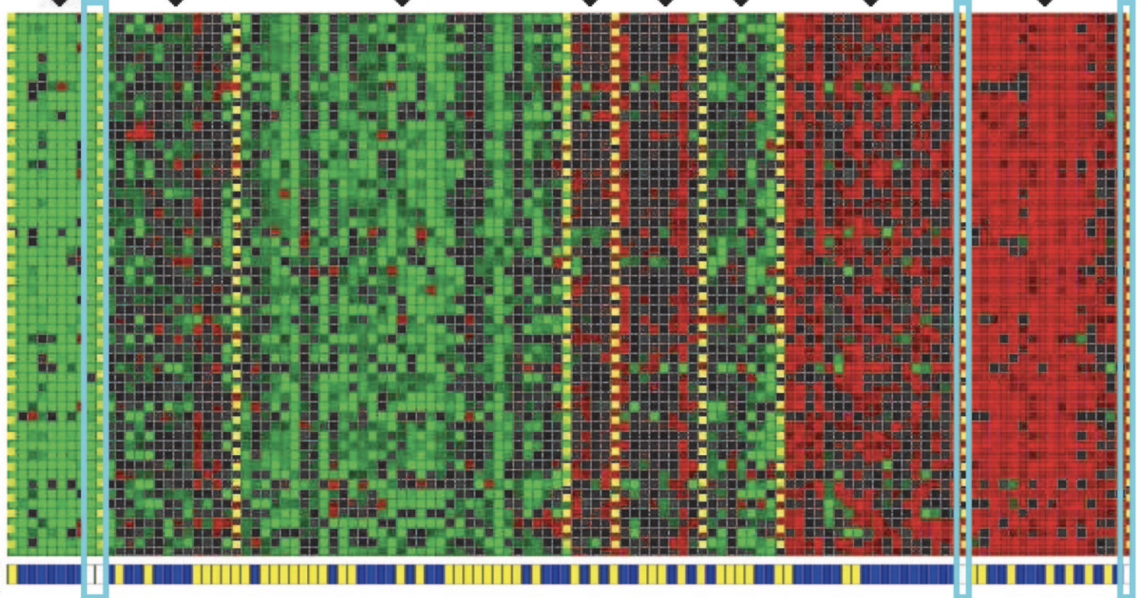
Clustering Genes
Cluster 1
Cluster 7
Genes
Individuals
Identifying Regulatory Mechanisms using Individual Variation Reveals Key Role for Chromatin Modification. [Su-In Lee, Dana Pe'er, Aimee M. Dudley, George M. Church and Daphne Koller. ’06]

Slide 15
Need for Unsupervised Learning
Annotating large datasets is very costly and time consuming. Example: Speech Recognition, Medical Image Analysis, etc.
There may be cases where we don’t know how many/what classes is the data divided into.
Example: Data Mining, Sentimental Analysis.
We may want to use clustering to gain some insight into the structure of the data before designing a classifier.

Slide 16
Disadvantages of Unsupervised Learning
Unsupervised Learning is harder as compared to Supervised Learning. Since, making the inference is difficult due to unavailable labels.
How do we know if results are meaningful since it has unlabelled data?
External evaluation- Expert analysis.
Internal evaluation- Objective function.

Slide 17

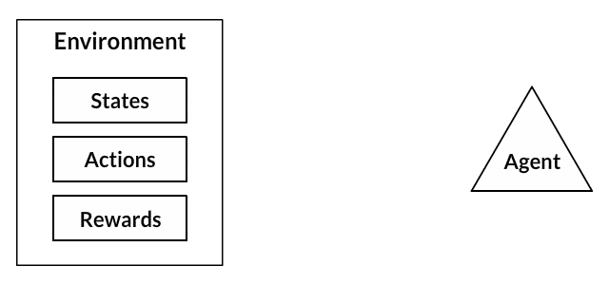
Reinforcement Learning
A reinforcement learning algorithm, or agent, learns by interacting with its environment. The agent receives rewards by performing correctly and penalties for performing incorrectly.
Reinforcement learning example: Fire fighting agent

Slide 18
Need for Reinforcement Learning
Reinforcement learning can be used to solve very complex problems that cannot be solved by conventional techniques.
In the absence of a training dataset, it is bound to learn from its experience.
Reinforcement learning models can outperform humans in many tasks and learning process is similar to human learning.
DeepMind’s AlphaGo program, a reinforcement learning model, beat the world champion Lee Sedol at the game of Go in March 2016.

Slide 19
Disadvantages of Reinforcement Learning
Reinforcement learning needs a lot of data and a lot of computation. It is data-hungry.
So for solving video games and puzzles it performs well.
Reinforcement learning assumes the world is Markovian, which it is not.
The Markovian model describes a sequence of possible events in which the probability of each event depends only on the state attained in the previous event.

Slide 20
What is classification problem?
Let there are two classes of objects.
– Class 1: Set of dog pictures
– Class 2: Set of cat pictures
Problem is
– Given a picture, you should say whether it
is cat or dog.
– For a human being it is easy…, but for a
machine it is a non-trivial problem.

Slide 21
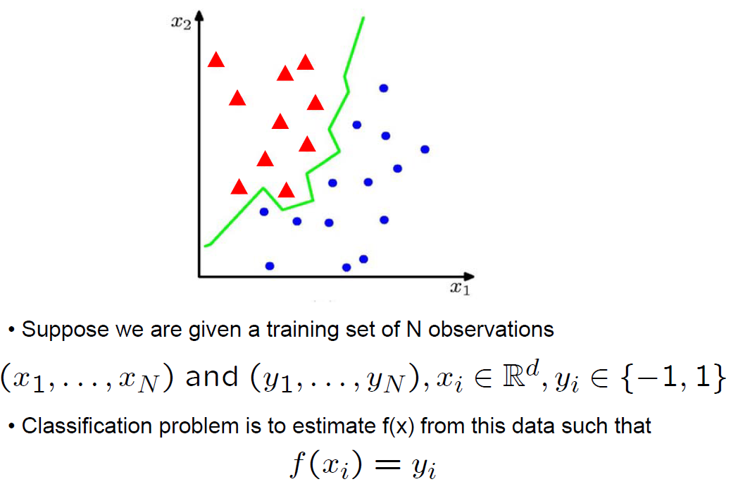
What is classification problem?

Slide 22
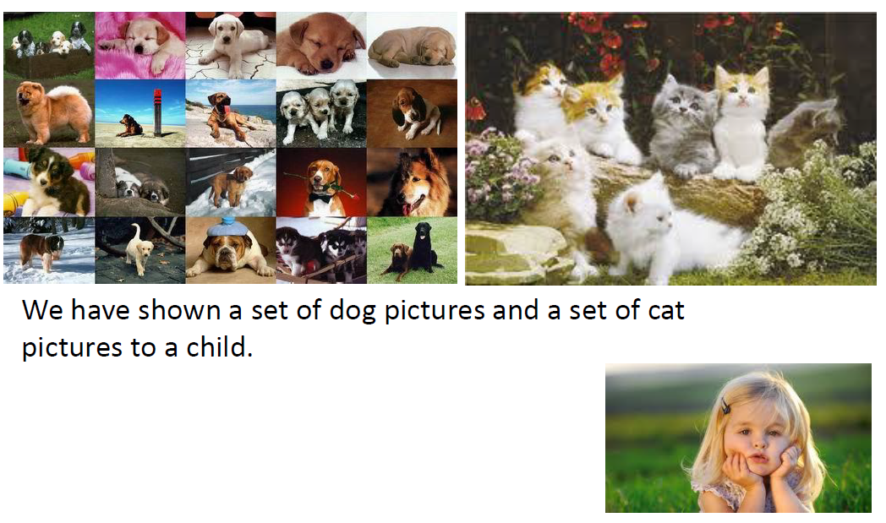
Classification: Supervised Learning
Training Phase

Slide 23
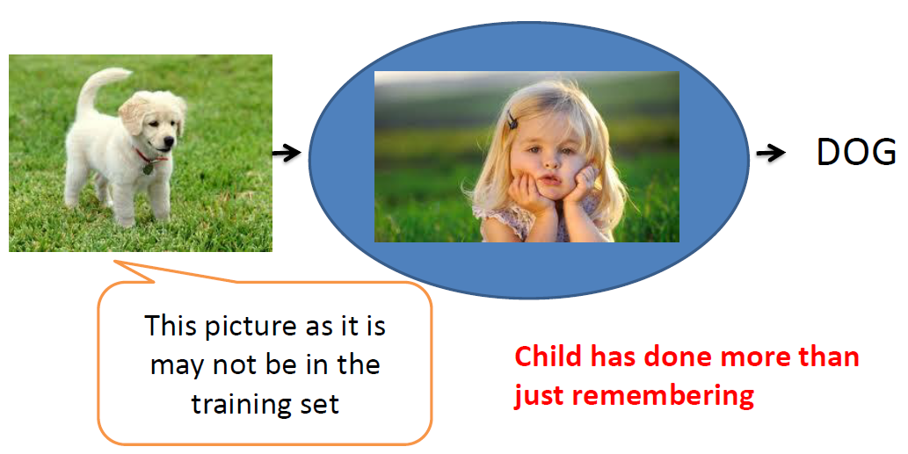
Classification: Supervised Learning
Testing Phase

Slide 24
What is Learning?
Child has learnt what is it that is common among dogs … and, what is it that is common among cats… also, what are the distinguishing features/attributes.
Child has learnt the pattern (regularity) behind all dogs and the pattern behind all cats.
Child then recognized a test image as having a particular pattern that is unique to dogs.

Slide 25
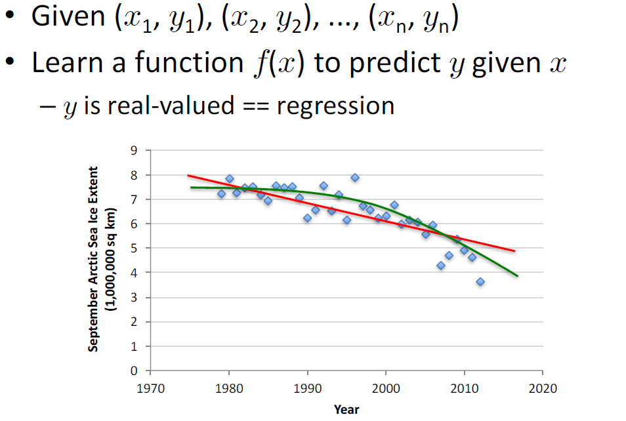
What is Regression Problem?

Slide 26
Popular ML algorithms
Classification
Regression
Linear Classifiers
Support Vector Machines
Decision Trees
K-Nearest Neighbor
Random Forest
Linear Regression
Logistic Regression
Polynomial Regression

Slide 27
Resources: Journals
Journal of Machine Learning Research www.jmlr.org
Machine Learning
IEEE Transactions on Neural Networks
IEEE Transactions on Pattern Analysis and Machine Intelligence
Annals of Statistics
Journal of the American Statistical Association

Slide 28
Resources: Conferences
International Conference on Machine learning (ICML)
European Conference on Machine Learning (ECML)
Neural Information Processing Systems (NIPS)
Computational Learning
International Joint Conference on Artificial Intelligence (IJCAI)
ACM SIGKDD Conference on Knowledge Discovery and Data Mining (KDD)
IEEE Int. Conf. on Data Mining (ICDM)

Slide 29
Thank You: Question?

